Slide 1
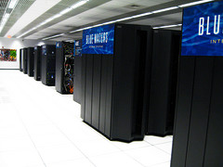
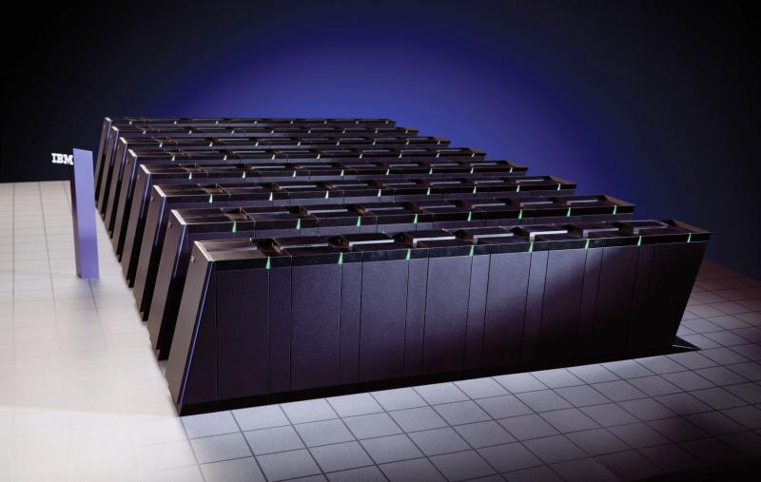
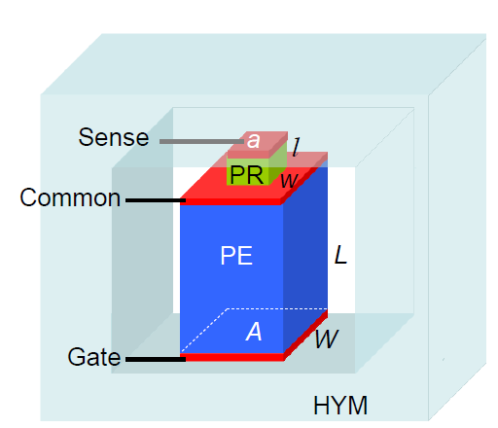
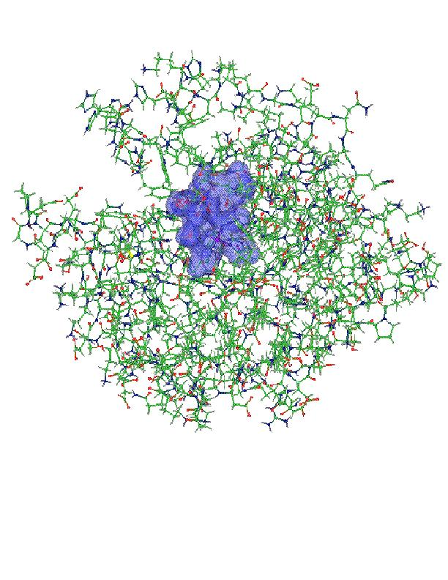
Projector Augmented Wave based
Kohn-Sham Density Functional Theory in OpenAtom with N² log N scaling
Qi Li¹, Eric Bohm², and Glenn J. Martyna¹
IBM TJ Watson Research Center, Yorktown Heights, NY
Computer Science, University of Illinois, Champaign-Urbana
Funding: NSF SI²

Slide 2
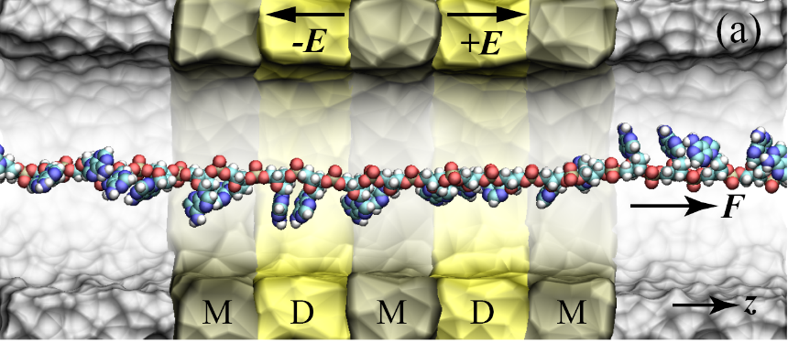
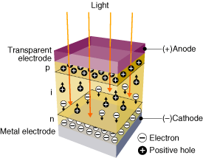
Goal : The accurate treatment of complex heterogeneous
systems to discern emergent and new physics
Light in
Hardware
Approach:
Scientific Insight
From Modeling
Physics-based solutions for complex systems
Software
Methods

Slide 3
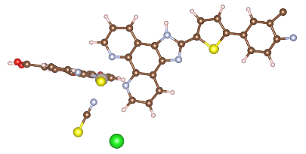
OpenAtom Concept: Statistical Sampling of Complex Environments is Key to Understanding many Physical Systems.
Biological function : enabled by fluctuations in both the environment and the biomolecules.
Pollutant detection: requires sampling complex aqueous systems and then exporting the results to a GW/GW-BSE app for computation of spectra.
Understanding chemical reactions in dense arrays:
requires non-trivial sampling of the full system due to complex many-body reaction paths.
OpenAtom: IBM (Martyna), UIUC (Kale) and Yale (Ismail-Beigi)
collaborate to build the Electronic Ground and Excited State parallel software and methods including nuclear motion capabilities to realize this vision (plane-waves).

Slide 4
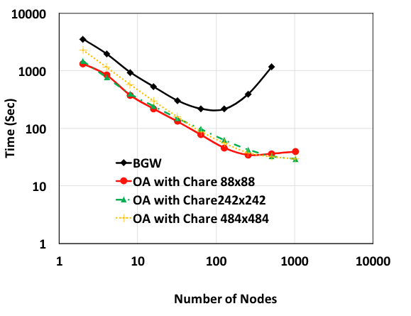
Key Project Accomplishments thus Far:
Electronic Ground State (charm++ parallelization): 1. High Parallel Scaling allows study of hydrogen storage in MOF’s via Path Integral CPAIMD.
2. Exact Exchange N² N^{1/3} log N (for metals & insulators): 10x speed 32 waters! (SIAM in prep).
3. Projector Augmented Wave method in N² log N (new results!).
September:
Full Software
Release
54 Si at 12 Ry
16 Si at 12 Ry6
Electronic Excited States (charm++ parallelization) 1. High Parallel Scaling for GW
2. N³ GW method based on a split propagator, imaginary time formalism (archive)

Slide 5
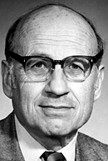
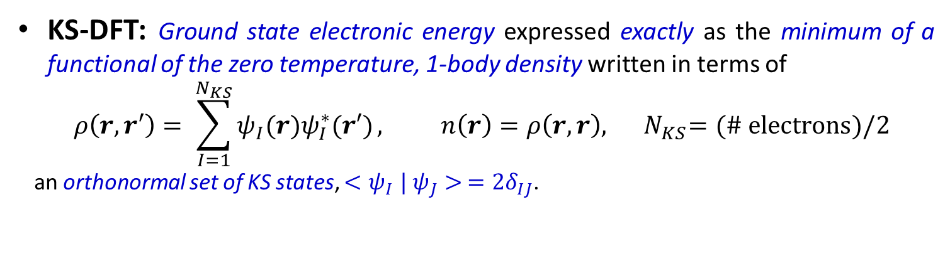
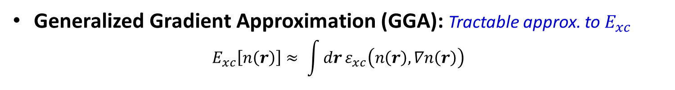
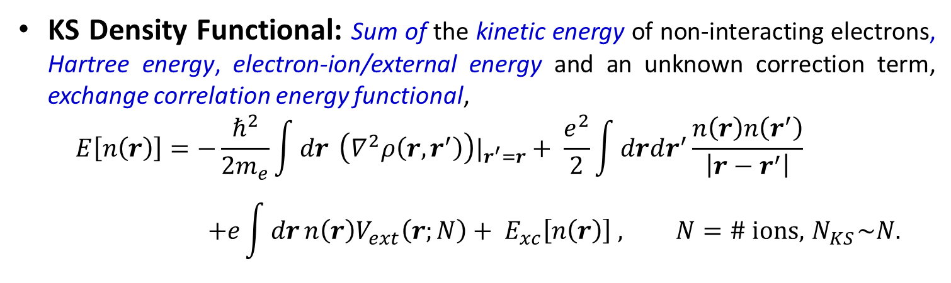
Kohn-Sham Density Functional Theory (KS-DFT): A workhorse of computational science.
KS-DFT: Ground state electronic energy expressed exactly as the minimum of a functional of the zero temperature, 1-body density written in terms of
$$ρ\left(r,r′\right)= \sum_{I=1}^{N_{KS}}{ψ_{I}(r)ψ_{I}^{∗}(r′)}, n\left(r\right)=ρ\left(r,r\right),{ N}_{KS}=(\# electrons)/2$$
an orthonormal set of KS states, ${<ψ}_{I}|$ $ψ_{J}> ={2δ}_{IJ}$.
Walter Kohn,
Nobel Chemistry 1998
KS Density Functional: Sum of the kinetic energy of non-interacting electrons, Hartree energy, electron-ion/external energy and an unknown correction term, exchange correlation energy functional,
$$E\left[n\left(r\right)\right]=−\frac{ℏ^{2}}{2m_{e}}\int{dr} \left(∇^{2}ρ\left(r,r^{′}\right)\right)|_{r^{′}=r}+ \frac{e^{2}}{2}\int{drdr^{′}}\frac{n\left(r\right)n\left(r^{′}\right)}{\left|r−r^{′}\right|} \\ +e\int{dr}n\left(r\right)V_{ext}\left(r;N\right)+ E_{xc}\left[n\left(r\right)\right] , N=\# ions, { N}_{KS}\sim N.$$
Generalized Gradient Approximation (GGA): Tractable approx. to $E_{xc}$
$$E_{xc}\left[n\left(r\right)\right]≈ \int{dr}ε_{xc}\left(n\left(r\right),∇n\left(r\right)\right)$$

Slide 6
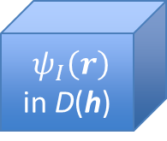
KS-DFT in OpenAtom
OpenAtom: Plane-wave (PW) based KS-DFT within the GGA – expand KS states in the delocalized PW basis.
$ψ_{I}\left(r\right)$ in D(h)
PW-KS-DFT in OpenAtom - Advantages:
N² log N or better scaling of interactions & derivatives - Euler Exponential Spline (EES) Interpolation.
Only orthogonalization is ~N³ .
High parallelism under charm++.
k-points, path integrals, LSDA & tempering implemented.
PW-KS-DFT in OpenAtom - Disadvantages:
Large basis set required - millions and millions (c.f. Carl Sagan).
Large memory required – need large machines.
Heavy atoms computationally intensive.

Slide 7
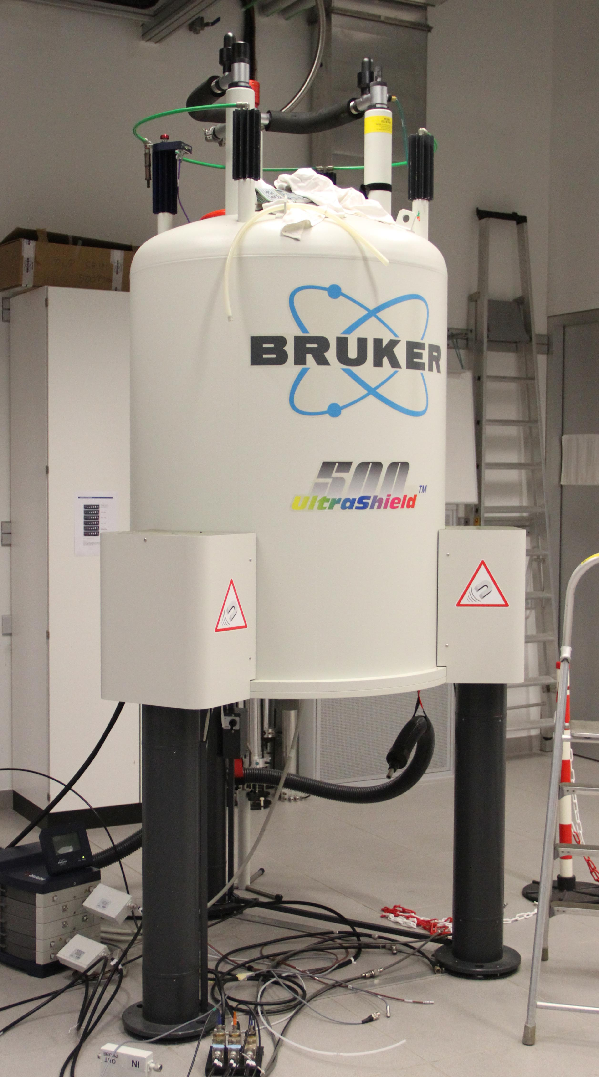
Projector Augmented Wave Method (PAW)
Projector-Augmented Wave (PAW) : accurate treatment of heavy atoms in KS-DFT with low computational cost.
PAW-KS-DFT Advantages
KS states split into localized and delocalized/smooth parts – small basis possible even for heavy atoms.
NMR and some other linear response methods require the core – PAW makes it easy.
Small memory requirement.
PAW-KS-DFT Disadvantages
Implemented with inefficient N³ methods for interactions.
Parallel performance of standard implementations poor.
Goal: Implement N² log N EES-based PAW with high parallel efficiency in OpenAtom.

Slide 8
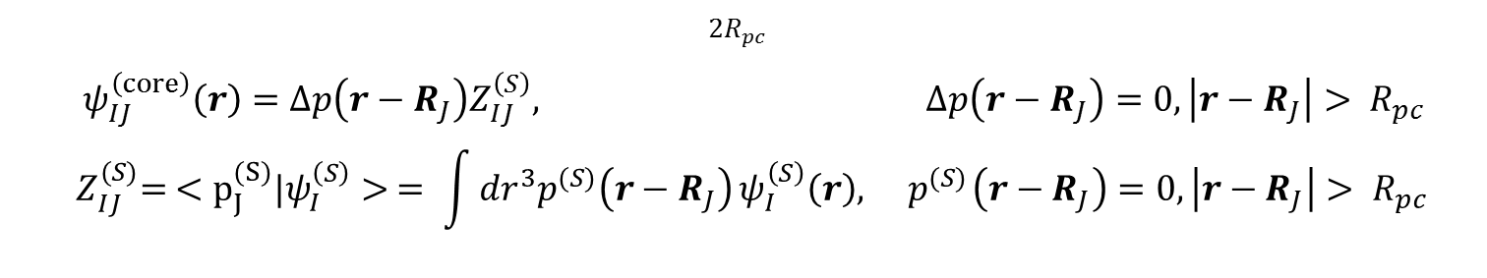
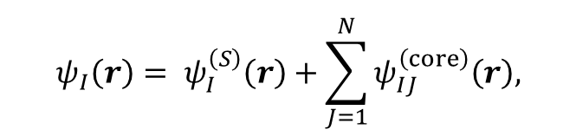
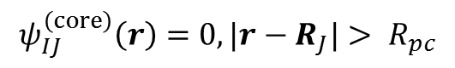
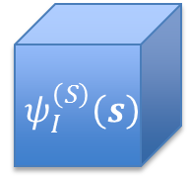
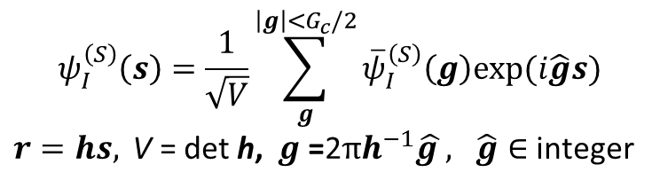
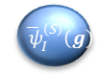
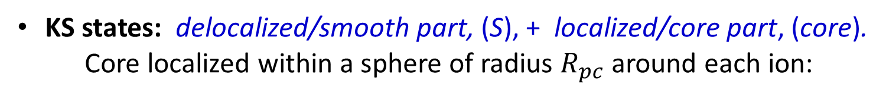
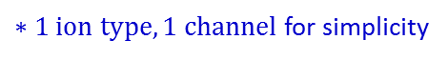
PAW Basics: KS states
KS states: delocalized/smooth part, (S), + localized/core part, (core). Core localized within a sphere of radius $R_{pc}$ around each ion:
$$ψ_{I}\left(r\right)= ψ_{I}^{\left(S\right)}\left(r\right)+\sum_{J=1}^{N}{ψ_{IJ}^{\left(core\right)}\left(r\right),}$$
$$ψ_{IJ}^{\left(core\right)}\left(r\right)=0, |r−R_{J}|> R_{pc}$$
Smooth: fills all spaces & varies, expanded in plane-waves:
$$ψ_{I}^{\left(S\right)}\left(s\right)=\frac{1}{\sqrt{V}}\sum_{g}^{\left|g\right|<G_{c}/2}{{\overline{ψ}}_{I}^{\left(S\right)}\left(g\right)exp⁡(i\hat{g}s)}$$ $r=hs, \text{V}\text{ = }\text{det} \text{h}\text{, } g\text{ =}\text{2}πh^{−1}\hat{g }, \hat{g}∈$ integer
$${ ψ}_{I}^{\left(S\right)}\left(s\right)$$
$${ \overline{ ψ}}_{I}^{\left(S\right)}\left(g\right)$$
Core: localized, written in terms of fixed core projectors, ${\left\{Δp{,p}^{(S)}\right\}}^{∗}:$
$${2R}_{pc}$$
$ψ_{IJ}^{\left(core\right)}\left(r\right)=Δp\left(r−R_{J}\right)Z_{IJ}^{\left(S\right)}, Δp\left(r−R_{J}\right)=0, \left|r−R_{J}\right|> R_{pc}$ $${ Z}_{IJ}^{(S)}= <p_{J}^{(S)}{|ψ}_{I}^{\left(S\right)}> = \int{{dr}^{3}p^{(S)}\left(r−R_{J}\right)}ψ_{I}^{\left(S\right)}\left(r\right),{ p}^{(S)}\left(r−R_{J}\right)=0, \left|r−R_{J}\right|> R_{pc}$$
$∗1 ion type, 1 channel$ for simplicity

Slide 9
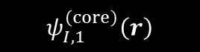


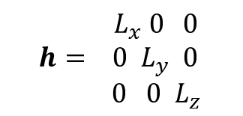
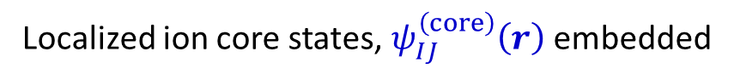

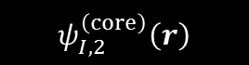

PAW Basics: Example KS state
$${ L}_{x} 0 0$$
$${h= 0 L}_{y} 0$$ ${ 0 0 L}_{z}$
Localized ion core states, $ψ_{IJ}^{\left(core\right)}\left(r\right)$embedded
$$ψ_{I,1}^{\left(core\right)}\left(r\right)$$
$$ψ_{I,2}^{\left(core\right)}\left(r\right)$$
$$L_{z}$$
$$ψ_{I}^{\left(S\right)}(r)$$
$$L_{y}$$
$$L_{x}$$
in the smooth part of the state, $ψ_{I}^{\left(S\right)}\left(r\right),$that fills D(h).

Slide 10
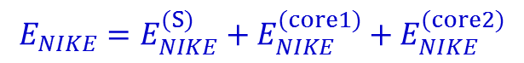
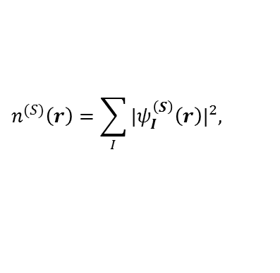
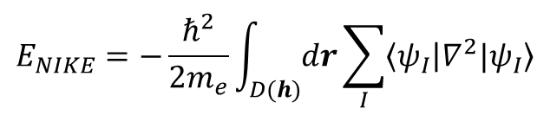
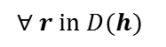
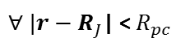
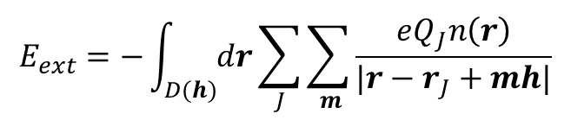
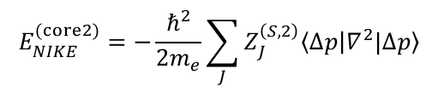
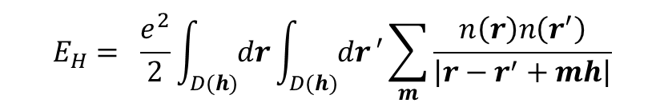
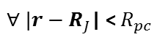
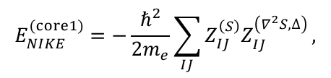
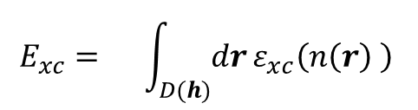
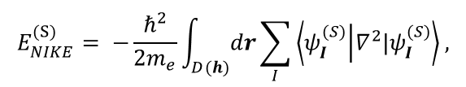
PAW Basics: KS-DFT within LDA under
periodic boundary conditions at Γ
The whole enchilada:
$$E\left[n\left(r\right)\right]=E_{NIKE}+E_{ext}+E_{H}+E_{xc}$$
$$E_{NIKE}=−\frac{ℏ^{2}}{2m_{e}}\int_{D(h)}{dr}\sum_{I}{\left\langle ψ_{I} | ∇^{2}{|ψ}_{I}\right\rangle }$$
$$E_{xc}= \int_{D(h)}{dr}ε_{xc}\left(n\left(r\right) \right)$$
$$E_{H}= \frac{e^{2}}{2}\int_{D(h)}{dr}\int_{D(h)}{dr}′\sum_{m}{\frac{n\left(r\right)n\left(r^{′}\right)}{\left|r−r^{′}+mh\right|}}$$
$$E_{ext}=−\int_{D(h)}{dr}\sum_{J}{\sum_{ m}{\frac{eQ_{J}n\left(r\right)}{|r−r_{J}+mh|}}}$$
Non-interacting electron kinetic energy: Smooth and core terms
$$E_{NIKE}=E_{NIKE}^{(S)}+E_{NIKE}^{(core1)}{+ E}_{NIKE}^{(core2)}$$
$$E_{NIKE}^{(S)}= −\frac{ℏ^{2}}{2m_{e}}\int_{D(h)}{dr}\sum_{I}{\left\langle ψ_{I}^{(S)} | ∇^{2}|ψ_{I}^{(S)}\right\rangle ,}$$
$$E_{NIKE}^{(core1)}=−\frac{ℏ^{2}}{2m_{e}}\sum_{IJ}{Z_{IJ}^{\left(S\right)}Z_{IJ}^{\left(∇^{2}S,∆\right)}},$$
$$E_{NIKE}^{(core2)}=−\frac{ℏ^{2}}{2m_{e}}\sum_{J}{Z_{J}^{\left(S,2\right)}\left\langle ∆p | ∇^{2}|∆p\right\rangle }$$
Exchange Correlation energy: Smooth and core terms
$$E_{xc}=E_{xc}^{(S)}+E_{xc}^{(core)}=\int_{D(h)}{dr}ε_{xc}\left(n^{(S)}\left(r\right) \right)+ \sum_{J}{\int_{D(R_{pc})}{dr}}\left[ε_{xc}\left(n_{J}\left(r\right) \right)−ε_{xc}\left(n_{J}^{(S)}\left(r\right)\right)\right]$$
core
$$n^{(S)}\left(r\right)=\sum_{I}{{{|ψ}_{I}^{\left(S\right)}\left(r\right)|}^{2}, }$$
$n_{J}\left(r\right)=n^{(S)}\left(r−R_{J}\right)+n^{(core1)}\left(r−R_{J}\right)$ + $n^{(core2)}\left(r−R_{J}\right)$, ${ n}_{J}^{(S)}\left(r\right)=n^{(S)}\left(r−R_{J}\right)$
$$∀ r in D(h)$$
$∀ |r−R_{J}$| <${ R}_{pc}$
$∀ |r−R_{J}$| <${ R}_{pc}$

Slide 11
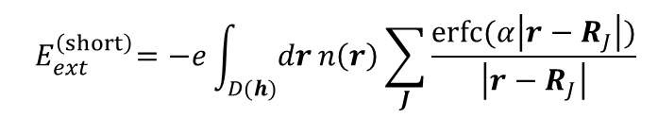
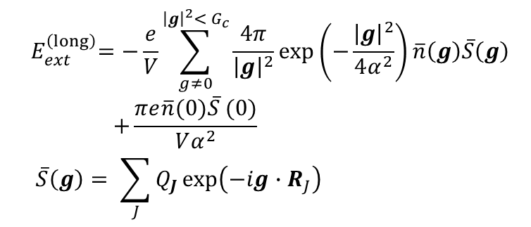
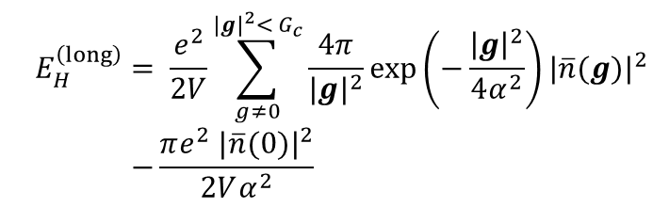
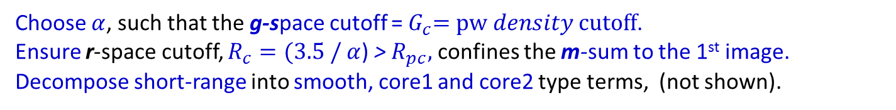
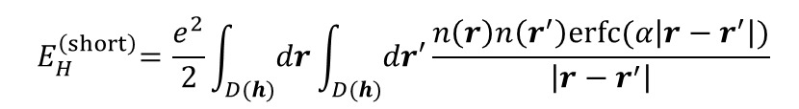
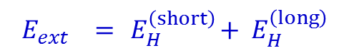
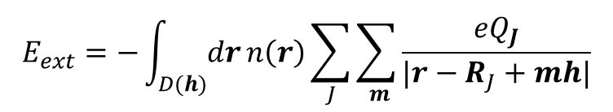
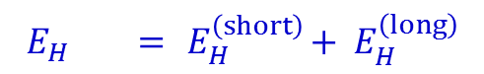
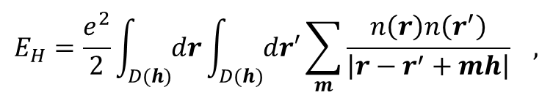
PAW Basics: KS-DFT long/short-range decomposition
Due to the mixed localized and delocalized basis, there is no natural truncation scale
for the long-range interactions of E_{H} and E_{ext} in g-space or r-space alone.
$$E_{H}=\frac{e^{2}}{2}\int_{D(h)}{dr}\int_{D(h)}{dr′}\sum_{m}{\frac{n\left(r\right)n\left(r^{′}\right)}{\left|r−r^{′}+mh\right|}} ,$$
$$E_{ext}=−\int_{D(h)}{dr}n\left(r\right)\sum_{J}{\sum_{ m}{\frac{{eQ}_{J}}{|r−R_{J}+mh|}}}$$
Using Poisson summation and Ewald’s decomposition of 1/r:
$$E_{H} ={ E}_{H}^{\left(short\right)}+{ E}_{H}^{\left(long\right)}$$
$$E_{ext} ={ E}_{H}^{\left(short\right)}+{ E}_{H}^{\left(long\right)}$$
$${ E}_{H}^{\left(short\right)}=\frac{e^{2}}{2}\int_{D(h)}{dr}\int_{D(h)}{dr′}\frac{n\left(r\right)n\left(r^{′}\right)erfc⁡(α\left|r−r^{′}\right|)}{\left|r−r^{′}\right|}$$
$${ E}_{ext}^{\left(short\right)}=−e\int_{D(h)}{dr}n\left(r\right)\sum_{J}{\frac{erfc⁡(α\left|r−R_{J}\right|)}{\left|r−R_{J}\right|}}$$
$${ E}_{H}^{\left(long\right)} = \frac{e^{2}}{2V}\sum_{g≠0}^{{|g|}^{2}<{ G}_{c}}{\frac{4π}{{|g|}^{2}}}exp\left(−\frac{{\left|g\right|}^{2}}{4α^{2}}\right){|\overline{n}(g)|}^{2} \\ −\frac{πe^{2} {|\overline{n}(0)|}^{2}}{2Vα^{2}}$$
$${ E}_{ext}^{\left(long\right)}=−\frac{e}{V}\sum_{g≠0}^{{\left|g\right|}^{2}<{ G}_{c}}{\frac{4π}{{\left|g\right|}^{2}}}exp\left(−\frac{{\left|g\right|}^{2}}{4α^{2}}\right)\overline{n}\left(g\right)\overline{S}\left(g\right) \\ +\frac{πe\overline{n}(0)\overline{S} (0)}{Vα^{2}} \\ \overline{S}\left(g\right)= \sum_{J}{Q_{J}}exp⁡\left(−ig∙R_{J}\right)$$
Choose $α$, such that the g-space cutoff =${ G}_{c}=pw density cutoff$.
Ensure r-space cutoff, $R_{c}=(3.5 /$ $α$) > $R_{pc},$ confines the m-sum to the 1st image.
Decompose short-range into smooth, core1 and core2 type terms, (not shown).

Slide 12
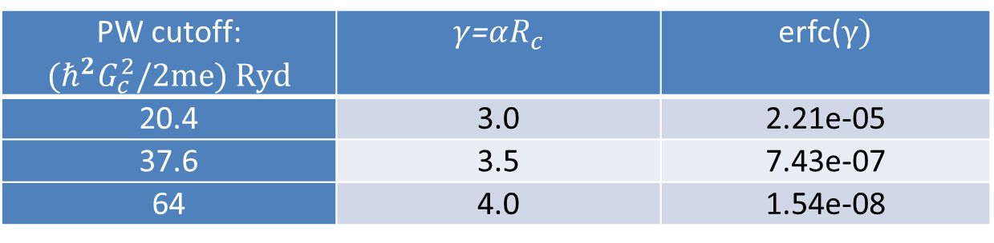

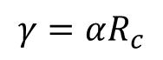
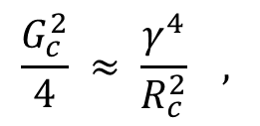
Accuracy of long/short decomposition
To approximately match long/short range accuracy:
$$\frac{G_{c}^{2}}{4} ≈ \frac{γ^{4}}{R_{c}^{2}} ,$$
$$γ=αR_{c}$$
$R_{c}=$ 4 bohr
PW cutoff: $${(ℏ^{2}G}_{c}^{2}/2me) Ryd$$ | $γ$=$αR_{c}$ | erfc($γ)$
20.4 | 3.0 | 2.21e-05
37.6 | 3.5 | 7.43e-07
64 | 4.0 | 1.54e-08
High accuracy can be obtained with both $R_{c}$ and $G_{c}$ small !

Slide 13






PAW Basics: Multi-Resolution, Grids, EES and N² log N scaling
How do we reduce scaling by one order in N and maintain accuracy?
1. Discrete real-space: Fourier Coefficients and FFTs
Given a discrete, $g\text{ =}\text{2}πh^{−1}\hat{g },$ finite g-space, |g|< $G_{c}$ , the Fourier coefficients, $\overline{f}(g)$ of f(r), can be converted to $\overline{f^{m}}\left(g\right)$ from f ^{m}(r) exactly using an intermediate equally spaced s-space grid, r=hs, of side N_{FFT,α} > $2m{\hat{g}}_{max,α}, ∆s_{\text{α}}=1/\text{N}\text{FFT}\text{,}\text{α}$.
Using FFTs, the $\overline{f^{m}}\left(g\right),$ can be computed exactly in N log N as:
$f\left(s\right)={\frac{1}{V}FFT}^{(m,+)}\left[\overline{f}\left(g\right),G_{c}\right],$ $\overline{f^{m}}(g)$ = ${\frac{V}{N_{FFT}}FFT}^{(m,−)}\left[f^{m}\left(s\right), mG_{c}\right]$, $\text{V}\text{ = }\text{det} \text{h}$
2. Euler Exponential Spline Interpolation and FFTs
To compute the Z-matrices, structure factors, $\overline{S}\left(g\right),$ and core functions, fast, it is useful develop a differentiable controlled approximation to $exp\left(ig∙r\right)$ on a discrete g-space for all r=hs in D(h) via interpolation from an equally spaced s-space grid, enabling the use of FFTs.
The Euler exponential spline (EES) delivers where M_{p} are the cardinal B-splines and p the spline order,
$$e^{2πi\hat{g}s}= D_{p}\left(\hat{g},N_{FFT}\right)\sum_{\hat{s}=0}^{N_{FFT}}{\sum_{j=1}^{p}{M_{p}\left(u−\hat{s}\right)e^{\frac{2πi\hat{g}\hat{s}}{N_{FFT}} }δ_{\hat{s},l−j}}}+𝒪{\left(\frac{2\hat{g}}{N_{FFT}}\right)}^{p},$$
$M_{p}$ has compact supp.
$$u\text{ = }\text{s} N_{FFT} l=int u$$
$$\text{N}\text{FFT} \text{> }2{\hat{g}}_{max}≈2.8{\hat{g}}_{max}$$
Using 3 FFT grids, (1) Psi EES, (2) Density, (3) Density EES, and 1 discrete spherical polar grid around each ion, |r|<R_{pc} , all PAW
energy terms & their derivatives can be accurately computed in N² log N .

Slide 14




































PAW Basics: g-space to s-space and back
Psi EES: $N_{g}^{(ψ)}\sim N$
Density:${ N}_{g}^{(ψ)}\sim N$
Density:${ N}_{g}^{(n)}\sim N$
Density EES:${ N}_{g}^{(n)}\sim N$
$${ \overline{ ψ}}_{I}^{\left(S\right)}\left(g\right)$$
$${\overline{n}}^{(S)}\left(g\right)$$
$${\overline{n}}^{(S)}\left(g\right)$$
$${ \overline{ψ}}_{I}^{\left(S\right)}\left(g\right)$$
$$g\text{ =}\text{2}πh^{−1}\hat{g }$$
$$g\text{ =}\text{2}πh^{−1}\hat{g }$$
$$g\text{ =}\text{2}πh^{−1}\hat{g }$$
$$g\text{ =}\text{2}πh^{−1}\hat{g }$$
$${\overline{ψ}}_{I}^{(S,D)}\left(g\right)={\overline{ψ}}_{I}^{\left(S\right)}\left(g\right)D^{(ψ)}(g)$$
${\overline{n}}^{\left(S,D\right)}(g)={\overline{n}}^{\left(S\right)}(g)D^{(n)}$ $(g$)
$${FFT }^{(ψ,+,EES)}\left[{\overline{ψ}}_{I}^{(S)}\left(g\right),\frac{G_{ }}{2}\right]$$
$${FFT }^{(n,−)}\left[{{\overline{n}}^{\left(S\right)}(s),G}_{c} \right]$$
$${FFT }^{(ψ,+,EES)}\left[{\overline{ψ}}_{I}^{(S,D)}\left(g\right),\frac{G_{ }}{2}\right]$$
$$\frac{V}{N_{FFT}^{(n)}}$$
$${FFT }^{(n,+,EES)}\left[{{\overline{n}}^{\left(S,D\right)}(g),G}_{c} \right]$$
$$\sqrt{V}$$
Psi: $N_{FFT}^{(ψ,EES)}\sim N$
Density: $N_{FFT}^{(n)}\sim N$
Density: $N_{FFT}^{(n)}\sim N$
Density EES: $N_{FFT}^{(n, EES)}\sim N$
$$ψ_{I}^{\left(S,D\right)}(s)$$
$$ψ_{I}^{\left(S\right)}(s)$$
${ s}_{α} ≡{\hat{s}}_{α}$/${ N}_{FFT,α}^{(ψ,EES)}$
0 ${≤\hat{s}}_{α}$<${ N}_{FFT,α}^{(ψ,EES)}$
$${{|ψ}_{I}^{\left(S\right)}\left(s\right)|}^{2}$$
$$n^{(S,D)}(s)$$
$$n^{(S)}(s)$$
$$r=hs$$
$$r=hs$$
$$r=hs$$
$$r=hs$$
$$r=hs$$
The $D^{(τ)}\left(g\right)=\prod_{α}{D_{p}}\left({\hat{g}}_{α},N_{FFT,α}^{(τ,EES)}\right)$enables B-spline interpolation

Slide 15









PAW Basics: r-space interpolation
EES provides an accurate, differentiable interpolation between
the different resolutions and length scales of PAW
Psi EES: $N_{FFT}^{(ψ,EES)}\sim N$
Density EES: $N_{FFT}^{(n, EES)}\sim N$
All grid spacings are independent of
system size.
h defines
D(h) = cuboid
V =det h ~ N
h defines
D(h) = cuboid
V =det h ~ N
$$ψ_{I}^{\left(S,D\right)}(s)$$
$$n^{(S,D)}(s)$$
N-ion cores in D(h): $N_{f}\text{\sim }\text{ 1}$
N-Partition
N-Partition
$${2R}_{pc}$$
$$R_{pc}\text{\sim }\text{1}$$
1
1
1
FFT grid points,
{$N_{J}^{(0,n/ψ)}$, $N_{J}^{(f,n/ψ)}$}, $$\text{s}∈near ion J$$
$$N_{J}^{(α,β)}\sim 1$$
for EES interpolation.
2
Fine
spherical polar
grid ($N_{f}$)
2
2
B-Spline
Interpolation
…
…
…
N
N
N
not to scale

Slide 16

Creating the r-space representation of the e-density
In the following, the multi-length scale PAW method is used to construct the electron density in N² log N as a demonstration:
$$n\left(r\right)= n^{\left(S\right)}\left(r\right)+\sum_{J}{\left[{n_{J}^{(core 1)}\left(r_{f}\right)+n}_{J}^{(core 2)}\left(r_{f}\right)\right], }{ n}_{J}^{(S)}\left(r_{f}\right)$$
Create the smooth KS states in real space, ${ ψ}_{I}^{\left(S\right)}\left(s\right)$: N² log N.
Create the smooth density in real space, $n^{\left(S\right)}\left(s\right)$: N².
*Create the smooth density in the ion cores, $n_{J}^{(S)}\left(r_{f}\right)$: N log N.
Create the smooth Z-matrix, $Z_{IJ}^{(S)}$ : N² log N.
*Create the core-2 densities, $n_{J}^{(core2)}\left(r_{f}\right)$: N².
*Create the core-1 densities, $n_{J}^{(core1)}\left(r_{f}\right)$: N² log N.
Formulae for all other components of PAW-DFT have been derived including ionic and pw expansion coefficient derivatives.
* New terms.

Slide 17







3. Creating the smooth density, $n_{J}^{(S)}\left(r_{f}\right)$ around each ion J, on the fine grid, f$∈N_{f}$
EES weighted
smooth density
in g-space
EES weighted smooth density
on discrete s-space
EES weighted smooth density
around each J
EES interpolated smooth density
around each J
1
1
B-Spline interpolation
N-Partition
2
2
$${FFT }^{(n,+,EES)}\left[{{\overline{n}}^{\left(S,D\right)}(g),G}_{c} \right]$$
3
3
$${\overline{n}}^{(S,D)}\left(g\right)=$$
$D^{(n)}(g)$ ${\overline{n}}^{\left(S\right)}\left(g\right)$,
$$\left|g\right|<G_{c}$$
$n^{\left(S,D\right)}\left(s\right)$,
$\text{s}{ ∈N}_{FFT}^{\left(n,EES\right)}$,
r$=hs$
…
…
_{N}
_{N}
$${ n}_{J}^{\left(S,D\right)}\left(s\right)\text{,} \\ N_{J}^{(f,n)}\text{:} \text{s}∈near J$$
$n_{J}^{(S)}\left({ r}_{f}\right)$,
$$\text{f} ∈N_{f}$$
N = number of ions, J=1..N, $N≠N_{KS}$
$N_{f}$= number points on spherical-polar grid around each ion.
$N_{f} \text{and} N_{J}^{(f,n)}\text{(}\text{s}∈near J)$independent system size .

Slide 18






















5. Creating the core density component, $n_{J}^{(core2)}\left(r_{f}\right),$
around each ion J, on the fine grid, $f∈N_{f}$
Reduction of $Z_{I1}^{(S)}$
$$∆p^{2}(r_{f})$$
$$Z_{1J}^{(S)} J=1…N$$
$$Z_{1}^{(S,2)}$$
$$n_{1}^{(core2)}\left(r_{f}\right)$$
$$Z_{11}^{(S)}$$
$$Z_{2J}^{(S)} J=1…N$$
$$Z_{21}^{(S)}$$
$$Z_{2}^{(S,2)}$$
$$n_{2}^{(core2)}\left(r_{f}\right)$$
$$Z_{3J}^{(S)} J=1…N$$
$$Z_{3}^{(S,2)}$$
$$n_{3}^{(core2)}\left(r_{f}\right)$$
$$Z_{N_{KS}1}^{(S)}$$
…
…
$$Z_{N_{KS}J}^{(S)} J=1…N$$
$$∆p^{2}(r_{f})$$
$$n_{N}^{(core2)}\left(r_{f}\right)$$
$$Z_{N}^{(S,2)}$$
Reduction of $Z_{IN}^{(S)}$
Each KS state contributes to N unique reductions
$$Z_{J}^{(S,2)}=\sum_{I}{{{|Z}_{IJ}^{(S)}|}^{2}}$$
In this example we have 1 projector
$$n_{J}^{(core2)}\left(r_{f}\right)= Z_{J}^{\left(S,2\right)}∆p^{2}\left(r_{f}\right) ∀ f∈N_{f}$$

Slide 19








6. Creating the core density component, $n_{J}^{(core1)}\left(r_{f}\right),$
around each ion J, on the fine grid, $f∈N_{f}$
EES weighted
KS states
in g-space
EES weighted
KS states
in s-space
EES weighted
KS states around J
EES interpolated
PAW 1 density
around each J
N reductions of s around J=1
1
1
1
1
$${FFT }^{(ψ,+,EES)}\left[{\overline{ψ}}_{I}^{(S,D)}\left(g\right),\frac{G_{ }}{2}\right]$$
Z₁₁
B-Spline interpolation
Z₂₁
2
2
2
2
Z₃₁
3
3
$$Z_{N_{KS}1}$$
3
3
…
…
…
…
N_{KS}
N_{KS}
_{N}
_{N}
N reductions of s around J=N
$${\overline{ψ}}_{I}^{(S,D)}\left(g\right)=$$ $D^{(ψ)}(g){\overline{ψ}}_{I}^{\left(S\right)}\left(g\right)$,
$$\left|g\right|<G_{c}/2$$
$$ψ_{I}^{\left(S,D\right)}\left(s\right),$$
$$\text{s}∈{ N}_{FFT}^{(ψ,EES)}$$
$ψ_{J}^{\left(S,D,Z\right)}\left(s\right)\text{, }$ $$N_{J}^{(f,ψ)}\text{:} \text{s}∈near J$$
$n_{J}^{\left(core1\right)}\left(r_{f}\right)$, $$\text{f} ∈N_{f}$$
Each KS state contributes to N unique reductions
$ψ_{J}^{\left(S,D,Z\right)}\left(s\right) \text{= }$ $\sum_{I}{{Z_{IJ}ψ}_{I}^{\left(S,D\right)}\left(s\right) ∀ }\text{s}∈near J:N_{B}^{(f,ψ)}$
${ Z}_{IJ}$ = weight for points $\text{s}∈near J$from KS state, I.

Slide 20



Grand Challenge Application: Perovskite solar cells
CH₃NH₃PbX₃
Pros:
High eff., low cost, tunable band gap (ABX₃)
Cons:
Instability: water, air, light, interface … &
toxic compounds.
Perovskite solar cells reach Si eff.
CH₃NH₃
PAW in OpenAtom
MAI-term.
PbI₂-term.
PbI₂-defect.
Understand: mechanism of instability/degradation.
Search: non-toxic B²⁺ (Fe, Co, Ni,…) for new high perf. materials.
Design: new interface/encapsulation for novel devices with long lifetime.
System size: 512 atoms (4x4x2 MAPbI₃ +128 water), 1264 states

Slide 21


Conclusions
PAW-KS-DFT is an important method in computational science that allows computations beyond PW-KS-DFT – heavy atoms.
Using EES Interpolation, we have derived a multi-length scale PAW technique that scales as N² log N (all energy terms and all derivatives) – an important advance and 100 pages of latex.
Charm++ parallel framework developed. Implementing now to allow systems with transition metals to be studied efficiently.

Slide 22
Supplementary: More PAW method pictures

Slide 23


Creating the g-space representation of the e-density
$$\overline{n}\left(g\right)= {\overline{n}}^{\left(S\right)}\left(g\right)+{\overline{n}}^{\left(core 1\right)}\left(g\right)+{\overline{n}}^{\left(core 2\right)}\left(g\right)$$
${ \overline{n}}^{\left(S\right)}\left(g\right)$: Sampling theorem from $n^{\left(S\right)}\left(s\right)$
${\overline{n}}^{\left(core 1\right)}\left(g\right)$: Numerical integration over core 1 density + EES
${\overline{n}}^{\left(core 2\right)}\left(g\right)$: Bessel transform (precompute) + EES
Create the smooth density in g-space,${ \overline{n}}^{\left(S\right)}\left(g\right)$: N log N.
*Create core-1 density in g-space, ${\overline{n}}^{\left(core 1\right)}\left(g\right)$: N log N
*Create core-2 density in g-space, ${\overline{n}}^{\left(core 2\right)}\left(g\right)$: N log N
*new terms

Slide 24









1. Creating the g-space representation of smooth density
Density: $N_{FFT}^{(n)}\sim N$
Density:${ N}_{g}^{(n)}\sim N$
$$\frac{V}{N_{FFT}^{(n)}}$$
$${FFT }^{(n,−)}\left[{{\overline{n}}^{\left(S\right)}(s),G}_{c} \right]$$
$$n^{(S)}(s)$$
$${\overline{n}}^{(S)}\left(g\right)$$
${ s}_{α} ≡{\hat{s}}_{α}$/${ N}_{FFT,α}^{(n)}$
0 ${≤\hat{s}}_{α}$<${ N}_{FFT,α}^{(n)}$
${ \hat{s}}_{α} integer$
$$r=hs$$
Density Fourier coefficients ${\overline{n}}^{(S)}\left(g\right) , \left|g\right|<{ G}_{c}$ are exact,
through intermediate discrete s-space – Theorem 1.
N log N method given $n^{\left(S\right)}\left(s\right).$

Slide 25







2. Creating the g-space core 1 density, ${\overline{n}}^{\left(core,1\right)}(g)$
EES interpolated
core 1 density
around each ion J
EES weighted core 1 density
around each J
EES weighted core 1 density
consolidated
EES interpolated
core 1 density
in g-space
1
1
2
2
N-Consolidation
B-Spline + f-quadrature
$${D^{(n)}(g)FFT }^{(n,−,EES)}\left[n_{}^{\left(core1,EES\right)}\left(s\right)\text{,} Gc \right]$$
3
3
$$n^{(core 1,EES,2)}\left(s\right)\text{,}$$
$$\text{s}∈{ N}_{FFT}^{(n,EES)}$$
$${\overline{n}}^{\left(core,1,EES,2\right)}\left(g\right)\text{,}$$
$$\left|g\right|<G_{c}$$
…
…
N-Consolidation
N-Consolidation
_{N}
$$n^{\left(core.1,EES,2 \right)}\left(s\right)= \sum_{J}{\sum_{s^{′} ∈ near J}{{ n}_{J}^{\left(core1,EES,2\right)}\left(s′\right)δ_{s,s′}}}$$
_{N}
$n_{J}^{\left(core1,EES\right)}\left(r_{f}\right)$, $$\text{f} ∈N_{f}$$
$${ n}_{J}^{\left(core1,ESS,2\right)}\left(s\right)\text{,} \\ { N}_{B}^{(f,n)}\text{:} \text{s}∈near J$$
g-space representation of core 1 density
$${ \overline{n}}^{\left(core,1,ESS\right)}\left(g\right)= \sum_{J}{\sum_{f}{{w_{f}n}_{J}^{\left(core,1,EES\right)}\left(r_{f}\right)\exp\left(ig∙\left(r_{f}+R_{J}\right)\right) }}$$
Treated
via EES above

Slide 26









3. Creating the g-space core 2 density, ${\overline{n}}^{\left(core 2,EES\right)}(g)$
Structure Factor $$S_{J}^{\left(Z,2, EES\right)}(s)$$
around each J
EES interpolated
Structure Factor $S_{}^{\left(Z,2,EES\right)}\left(s\right)$
EES interpolated g-space
core 2 density
$Z_{J}^{(S,2)}$ vector
$$Z_{1}^{(S,2)}$$
1
B-Spline
$$Z_{2}^{(S,2)}$$
2
N-Consolidation
$$D^{(n)}\left(g\right)\tilde{{Δp}^{2}} (g)$$
$${ × FFT }^{(n,−,EES)}\left[S^{\left(Z,2,EES\right)}\left(s\right)\text{,} Gc\right]$$
$$Z_{3}^{(S,2)}$$
3
…
…
$$S^{\left(Z,2,EES\right)}\left(s\right) \text{,}$$
$$\text{s}∈{ N}_{FFT}^{(n,EES)}$$
$${\overline{n}}^{\left(core,2,EES\right)}\left(g\right)\text{,}$$
$$\left|g\right|<G_{c}$$
N-Consolidation
$$Z_{N}^{(S,2)}$$
$${\overline{S}}^{\left(Z,2\right)}\left(g\right)= \sum_{J}{Z_{J}^{\left(S,2\right)}exp(ig∙ R_{J})}$$
Treated via EES to achieve N log N
_{N}
$$S_{J}^{\left(Z,2,EES\right)}\left(s\right)\text{,}$$
$$N_{B}^{(0,n)}\text{:} \text{s}∈near J$$
core 2 density in g-space by EES
$${\overline{n}}^{\left(core,2,EES\right)}\left(g\right)=\tilde{{Δp}^{2}}\left(g\right){\overline{S}}^{\left(Z,2,EES\right)}\left(g\right) ∀ \left|g\right|<G_{c}$$

Slide 27
Creating the Energy
Kinetic Energy of non-interacting electrons
Smooth
Core 1*
Core 2*
Local e-ion energy
Smooth
Core 1 (short and long)*
Core 2 (short and long)*
Exchange-Correlation
Smooth
Core*
Hartree
Smooth-Smooth : long + short range
Long range*
Smooth-Core 1/2 : short range*
Core 1/Core 2 : short range*
*new terms

Slide 28







1. Kinetic Energy of non-interacting electrons
$$E_{NIKE}=E_{NIKE}^{(S)}+E_{NIKE}^{(core1)}{+ E}_{NIKE}^{(core2)}$$
$$E_{NIKE}^{(S)}= −\frac{ℏ^{2}}{2m_{e}}\int_{D(h)}{dr}\sum_{I}{\left\langle ψ_{I}^{(S)} | ∇^{2}|ψ_{I}^{(S)}\right\rangle = }\frac{ℏ^{2}}{2m_{e}}\sum_{I}{\sum_{g}^{\left|g\right|<G_{c}/2}{g^{2}{|{\overline{ψ}}_{I}^{(S)}\left(g\right)|}^{2}}}$$
$$E_{NIKE}^{(core1)}=−\frac{ℏ^{2}}{2m_{e}}\sum_{IJ}{Z_{IJ}^{\left(S\right)}Z_{IJ}^{\left(∇^{2}S,∆\right)}}$$
*
$$E_{NIKE}^{(core2)}=−\frac{ℏ^{2}}{2m_{e}}\sum_{J}{Z_{J}^{\left(S,2\right)}\left\langle ∆p | ∇^{2}|∆p\right\rangle ={∆p}^{(KE)}\sum_{J}{Z_{J}^{\left(S,2\right)} }}$$
*
$$= −\frac{ℏ^{2}}{2m_{e}}\int_{D(R_{pc})}{dr∆p(r)}∇^{2}∆p(r)$$
$${∆p}^{(KE)}=constant$$
*new terms
Note, the EES computation of $Z_{J}^{\left(S,2\right)}$ and $Z_{IJ}^{\left(S\right)}$ has already been presented and computing
$${ Z}_{IJ}^{\left(∇^{2}S,∆\right)}= −\frac{ℏ^{2}}{2m_{e}}\int_{D\left(h\right)}{dr} ∆p(r−R_{J})∇^{2}ψ_{I}^{\left(S\right)}(r)$$
by EES just requires utilizing a slightly different input in slide 17,
$${\overline{ψ}}_{I}^{(∇^{2}S,D,∆p)}\left(g\right)=D^{\left(ψ\right)}\left(g\right)g^{2}{\overline{ψ}}_{I}^{\left(S\right)}\left(g\right)\tilde{∆p}(g)$$

Slide 29
2. Local electron-ion energy

Slide 30
3. Exchange Correlation

Slide 31
4. Hartree

Slide 32

Creating the $ψ_{I}^{\left(S\right)∗}(s)$ derivatives

Slide 33
Creating the ionic derivatives

Slide 34
Creating the S-matrix and orthogonalization

Slide 35




Accuracy of long/short decomposition
To approximately match long/short range accuracy:
$$\frac{G_{c}^{2}}{4} ≈ \frac{γ^{4}}{R_{c}^{2}} ,$$
$$γ=αR_{c}$$
$R_{c}=$ 4 bohr
PW cutoff: $${(ℏ^{2}G}_{c}^{2}/8me) Ryd$$ | $γ$=$αR_{c}$ | erfc($γ)$
5.1 | 3.0 | 2.21e-05
9.4 | 3.5 | 7.43e-07
16 | 4.0 | 1.54e-08
$R_{c}=$ 2 bohr
PW cutoff: $${(ℏ^{2}G}_{c}^{2}/8me) Ryd$$ | $γ$=$αR_{c}$ | erfc($γ)$
20.3 | 3.0 | 2.21e-05
37.5 | 3.5 | 7.43e-07
64.0 | 4.0 | 1.54e-08
High accuracy can be obtained with both $R_{c}$ and $G_{c}$ small !

Slide 36







1. Creating the smooth part of the KS states,${ ψ}_{I}^{\left(S\right)}\left(s\right)$, on the density s-space FFT grid, ${s∈N}_{FFT}^{(n)}$
Smooth part
of the KS states
in g-space
Smooth part
of the KS states
on discrete s-space
$${\frac{1}{\sqrt{V}}FFT }^{(n,+)}\left[{\overline{ψ}}_{I}^{\left(S\right)}\left(g\right),\frac{G_{c}}{2}\right]$$
1
1
2
2
$${\overline{ψ}}_{I}^{\left(S\right)}\left(g\right),$$
|g|< $\frac{G_{c}}{2}$,
$ψ_{I}^{\left(S\right)}(s)$,
$\text{s}∈{ N}_{FFT}^{(n)}$,
r$=hs$
3
3
$$g\text{ =}\text{2}πh^{−1}\hat{g },$$
…
…
$\hat{g}∈$ integer
Notation for
discrete s
N_{KS}
N_{KS}
${ s}_{α} ≡{\hat{s}}_{α}$/${ N}_{FFT,α}^{(n)}$
0 ${≤\hat{s}}_{α}$<${ N}_{FFT,α}^{(n)}$
r$=hs$
N_{KS} is the number of KS states

Slide 37




2. Creating the smooth density, $n^{\left(S\right)}\left(s\right)$
on the density s-space FFT grid, $s∈N_{FFT}^{(n)}$
Smooth part
of the KS states
on discrete s-space
Smooth part
of the density
on discrete s-space
1
Point by point sum of mod squares
$${{|ψ}_{I}^{\left(S\right)}\left(s\right)|}^{2} \\ \text{s}{ ∈N}_{FFT}^{(n)},$$
r $=hs$
2
$n^{\left(S\right)}\left(s\right)$,
$$\text{s}{ ∈N}_{FFT}^{(n)},$$ r$=hs$
3
…
N_{KS}
Point by point sum of mod squares:
$$n^{\left(S\right)}\left(s\right)=\sum_{I}{{{|ψ}_{I}^{\left(S\right)}(s)\text{|}}^{2}} ∀ s{ ∈N}_{FFT}^{(n)}$$

Slide 38















4. Creating the $Z_{IJ}^{(S)}$ the matrix elements
EES x ${\tilde{p}}^{\left(S\right)}$
weighted KS states
in g-space
EES x ${\tilde{p}}^{\left(S\right)}$
weighted KS states
in s-space
N–Partition,
N B-Spline Interpolations
per KS state
Smooth
Z-matrix
1
$$N_{B}^{(0,ψ)}$$
$\text{s}∈$ near ion 1
1
1
$$Z_{1J}^{(S)} J=1…N$$
$${FFT }^{(ψ,+,EES)}\left[{\overline{ψ}}_{I}^{(S,D,\tilde{p}) }\left(g\right),\frac{G_{ }}{2}\right]$$
N-Partition,
N B-Spline Interps.
$$N_{B}^{(0,ψ)}$$
$\text{s}∈$ near ion 2
2
2
$$Z_{2J}^{(S)} J=1…N$$
2
$$N_{B}^{(0,ψ)}$$
$\text{s}∈$ near ion 3
3
3
$$Z_{3J}^{(S)} J=1…N$$
3
…
…
…
$$N_{B}^{(0,ψ)}$$
$\text{s}∈$ near ion N
N_{KS}
N_{KS}
$$Z_{N_{KS}J}^{(S)} J=1…N$$
_{N}
$${\overline{ψ}}_{I}^{(S,D,\tilde{p})}\left(g\right)=$$ $D^{(ψ)}(g){\overline{ψ}}_{I}^{\left(S\right)}\left(g\right){\tilde{p}}^{\left(S\right)}(g)$,
$$\left|g\right|<G_{c}/2$$
$$ψ_{I}^{\left(S,D,\tilde{p}\right)}\left(s\right),$$
$$\text{s}∈{ N}_{FFT}^{(ψ,EES)}$$
$$Z_{IJ}^{(S)} J=1…N$$
A small set of points, $\text{s}∈$ near ion J, interpolated to obtain $Z_{1J}^{(S)}$ for all I,J ($N_{B}^{(0,ψ)}$~1),
$$Z_{IJ}^{(S)}=\sum_{\text{s} ∈ near J}^{N_{B}^{(0,ψ)}}{ψ_{I}^{\left(S,D,\tilde{p}\right)}\left(s\right)M_{J,p}^{(3)} (s)}$$
$\text{s}∈$ near ion J independent of I as are B-splines,${ M}_{J,p}^{(3)}(s)$

